Slide 1





E-Newsletter UPAROI Society
Zero Edition : The Beginning
Dr Pavan Kumar Dr Md Shadab Alam
(President) (General Secretary)
Dr. Kailash Kumar Mittal
(Treasurer)
(1988 – 2025)

Slide 2


Slide 3
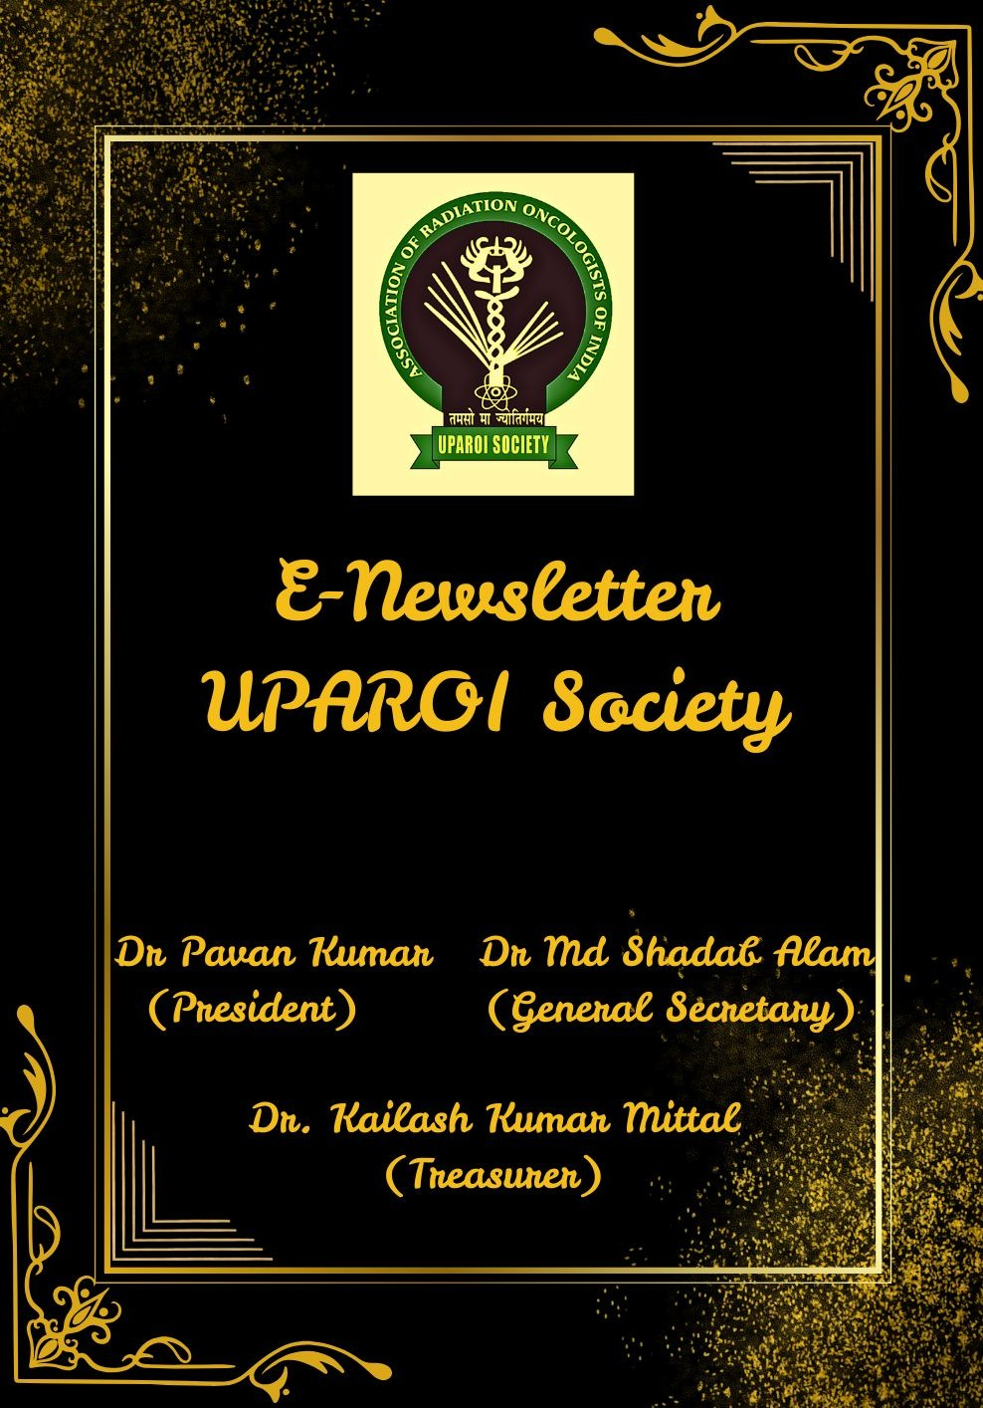

Slide 4

UPAROI Society
Words of Wisdom”
Let us be informed……

Slide 5
Messages
Office Bearers
National AROI

Slide 6

Prof Manoj Gupta
Chair, AROI
Professor, Radiation Oncology, AIIMS Rishikesh
I am happy to learn that UP chapter of Association of Radiation Oncology is starting an E-newsletter, a new initiative designed to keep the members informed about the latest developments in our field, as well as important news from our community. This will help in sharing updates on cutting-edge treatments, new research breakthroughs, patient success stories, and upcoming events. I am sure that the goal of starting this newsletter will be to foster a greater sense of community among healthcare providers, researchers, and patients, while providing valuable information to help everyone stay at the forefront of radiation oncology. As we continue to advance the quality of care for our patients and improve outcomes through innovation, I hope this newsletter serves as a platform for communication, learning, and collaboration. Together, we can continue to make strides in providing the best care possible to those who need it most. I wish you all the best.

Slide 7
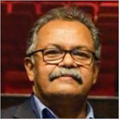
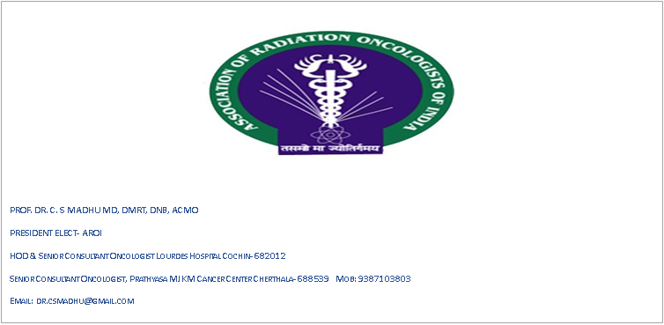
Your loving
Prof. Dr. C. S Madhu MD, DMRT, DNB, ACMO
Dear colleagues, Date: 30-03-2025
I am extremely happy to note that the UPAROI society are planning to start publishing of an E-newsletter. It would be a pathbreaking step which all other state AROI societies are likely to follow and adopt. I can foresee circulation of academic, professional, literary &scientific information and I don’t have any doubt that it would be useful to one and all in our clinical oncology community. Please send the newsletter to all AROI members
I wish this brilliant step all the success.
Your loving
Prof. Dr. C. S Madhu
MD, DMRT, DNB, ACMO

Slide 8
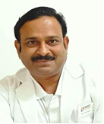

Dr. V. Srinivasan
M.D., F.I.P.M., F.I.C.R.O.
AROI-SECRETARY GENERAL
Heartiest Congratulations on the Initiative of the E-Newsletter by UP AROI Society.
It is with great pleasure that I extend my heartfelt congratulations to UP AROI Society on the launch of their E-Newsletter. This initiative is a commendable step toward enhancing communication, knowledge sharing, and professional engagement within our fraternity.
Such efforts play a crucial role in keeping our members informed about the latest developments, research, and academic advancements in the field of Radiation oncology. I am confident that this platform will serve as a valuable resource for both seasoned professionals and aspiring students. I appreciate the dedication and vision of UP AROI Society in taking this initiative forward and look forward to seeing it grow and flourish. Wishing you all success in this endeavour!
Dr. V. Srinivasan

Slide 9
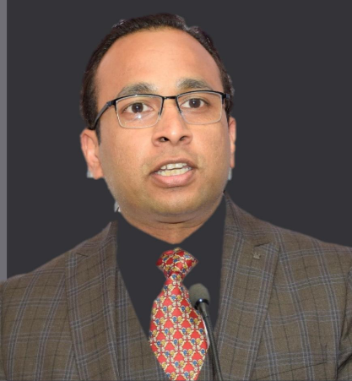
Dr. Vikas Jagtap
Vice President (Jr). - AROI
Additional Professor & HoD
NEIGRIHMS, Shillong
It gives me immense pleasure to congratulate the UP AROI team for the successful launch of its first E Newsletter. The newsletter is a reflection of activities of any association and in its true sense it reflects the mind & soul of its members who had worked relentlessly to make the association a successful organization. I am sure that the newsletter will be personalised to the needs of UP AROI members. The readers will be happy to get information about the activities of association and the academic contents will make them more learned in the field of oncology. I wish continued collaboration and engagement of the UP AROI members through the newsletter with a focus to create more value for our members, enhance their experience, increase member satisfaction, attract new members, and collaborate with national association to increase awareness. I expect post graduate trainee engagement in making the newsletter successful to improve the overall standards of post-graduate teaching, clinical practice, and adequate growth of this discipline as per the motto of AROI.
Once again, I sincerely admire the motivation and enthusiasm of the UP AROI team and wish for a long-term legacy in future.
Best wishes…

Slide 10
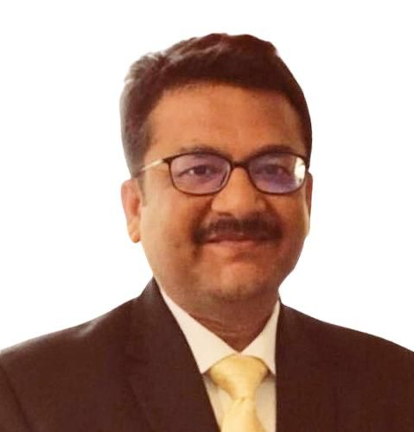
Dr Gautam Kumar Sharan
Vice Chairman ICRO
Medical Officer ‘G’
HOD, Radiation Oncology,
Homi Bhabha Cancer Hospital & Reserach Centre, Muzaffarpur
A unit of Tata Memorial Centre, Mumbai
I take this opportunity to Congratulate the Office bearers and members of UP chapter of AROI, on the successful compilation of state chapter newsletter!
The hard work and dedication have truly paid off, and it's exciting to see UP-AROI’s vision coming to life.
It is great to get to know various academic sessions held in the state and an academic delight to read the very engaging articles included in the newsletter.
Wishing you continued success as you share your valuable content with the colleagues!

Slide 11
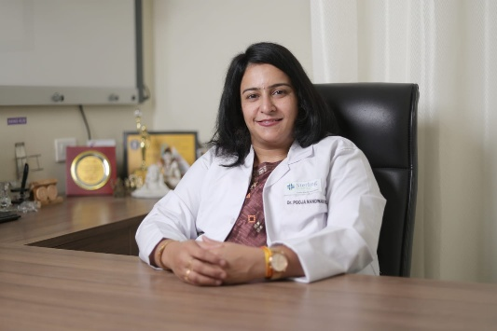
Dr Pooja Nandwani Patel
ICRO Secretary
Director - Radiation Oncology
Sterling Hospitals, Ahmedabad
I am happy to hear that AROI UP Chapter have started their own newsletter and this initiative will be a great welcoming step for networking, sharing knowledge and information amongst colleagues. I congratulate the office bearers and extend my best wishes to UP AROI for this initiative and looking forward to interesting updates from them regularly.
Best wishes
Pooja

Slide 12
Messages
Office Bearers
UPAROI Society

Slide 13
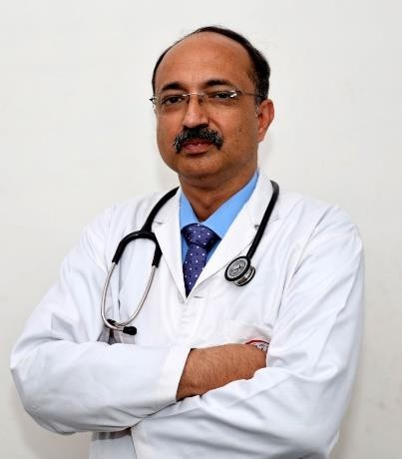
Dr. Pavan Kumar
(President UPAROI)
Professor, Department of Radiation Oncology & Head Quality Assurance
Shri Ram Murti Smarak Institute of Medical Sciences Bareilly, Uttar Pradesh
It is my immense pleasure to announce that we are starting our E- Newsletter of UPAROI society. This newsletter will keep us updated of the work done in our fraternity. It will also keep all the faculties and residents updated regarding the events going to be held in our state under the aegis of Association of Radiation Oncologist of UPAROI Society. It will be the great academic and informative platform to share our scientific work and events.
I wish our UPAROI society best of luck for this endeavor.

Slide 14
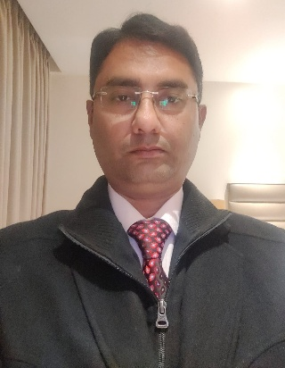
From The Desk of General Secretary, UPAROI Society
Zero Edition of the E-Newsletter
Dr Md Shadab Alam
Department of Radiation Oncology, JNMC, AMU, Aligarh
Dear Members of the UPAROI Society,
With great enthusiasm, we extend our heartfelt wishes as we launch the first edition of the UPAROI Society Newsletter! This marks the beginning of a new journey—one where ideas, achievements, and aspirations come together to inspire and unite us.
May this newsletter serve as a platform for knowledge, collaboration, and progress, fostering a stronger and more connected community. Wishing the team behind this initiative great success in making it informative and impactful!
Best regards,
Dr Md Shadab Alam
General Secretary
UPAROI Society

Slide 15
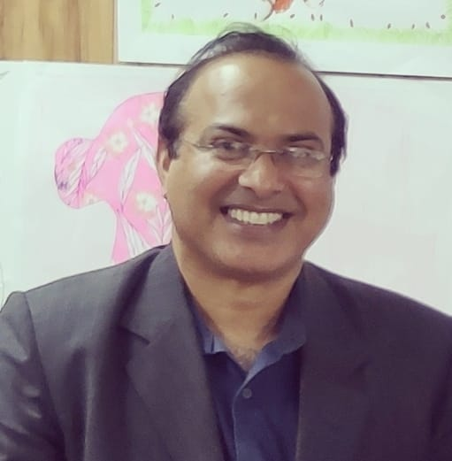
Dr Kailash Kumar Mittal
(Treasurer, UPAROI)
Professor & Head
Department of Radiation Oncology
UPUMS, Saifai
Congratulations on launching the first newsletter of UPAROI Society —what an exciting milestone! This is just the beginning of a journey filled with creativity, connection, and impact. Our voice and ideas deserve to be heard, and I have no doubt our newsletter will inspire and engage the readers.
Wishing endless inspiration, growing subscribers, and the joy of sharing passion with the world. Here’s to our first edition and many more to come!
Cheers to this success of UPAROI Society!
Warmest wishes

Slide 16
Messages
Honorary Advisory Committee
UPAROI Society

Slide 17
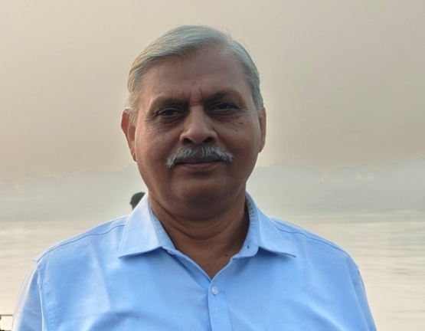
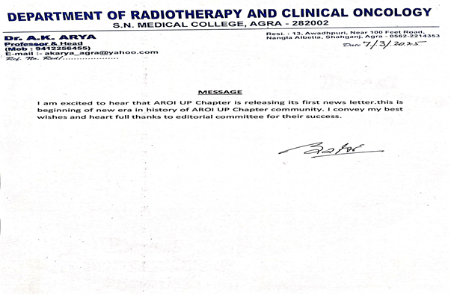
Prof. A K Arya
Department of Radiotherapy & Clinical Oncology, SNMC, Agra

Slide 18
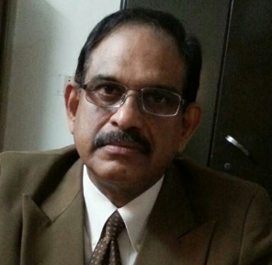
Dr B Paul Thailliath
Chief Consultant
RCC KNMH Prayagraj
Regional Oncology update by E-newsletter need of the day. Congratulations Dr Mohd Shadab Alam for the initiative.

Slide 19
Messages
Executive Committee
UPAROI Society

Slide 20
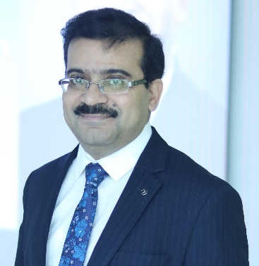
Dr Madhup Rastogi
Professor & HOD
Department of Radiation Oncology
Dr. RMLIMS, Lucknow - 226010 (U.P) INDIA
Ex PRESIDENT UP AROI
I feel excited to see the inaugural edition of our AROI UP chapter Newsletter. This aims to keep all of us informed and engaged with the latest advancements in our field, important updates from our chapter, upcoming events, and opportunities for professional development and collaboration. As radiation oncology continues to evolve, our chapter remains committed to fostering a vibrant community of healthcare professionals dedicated to providing the highest standard of care to our patients.
This newsletter will serve as a platform for sharing knowledge, celebrating achievements, and addressing the challenges we face together.
I congratulate all the executive members for this initiative.

Slide 21
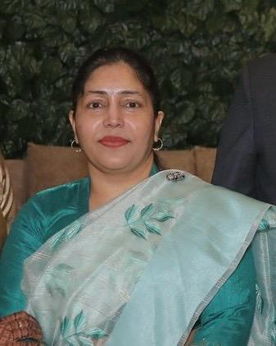
Dr. Surabhi Gupta
Professor and Head
Dept of Radiation oncology
S.N. Medical College, Agra
Namaskar Everyone,
It is with great pleasure that we announce the launch of the UP Chapter of the Association of Radiation Oncologists of India’s official website and E-newsletter. This platform will provide you with the latest updates, valuable insights, and job opportunities, all at your fingertips. It is the perfect way to stay connected and engaged with the community.
I extend my heartfelt congratulations to the office bearers for this remarkable achievement. I encourage all members of UPAROI to actively contribute to the growth and progress of our society.
Stay tuned for more exciting updates in the months to come!

Slide 22
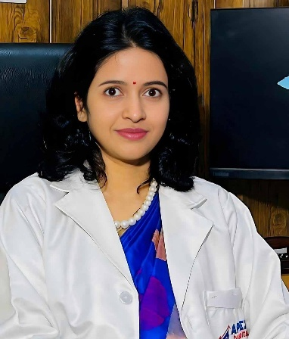
Dr Ankita Patel
Director, Apex Hospital, Varanasi
Dear UPAROI Community,
As we present this edition of our newsletter, I want to take a moment to wish you all the best of luck on your continued journey with UPAROI. Together, we are building a future of growth, learning, and collaboration. This newsletter is a reflection of our shared efforts, and I encourage each of you to take full advantage of the opportunities it brings.
Let’s continue fostering an environment where knowledge thrives and every member has the chance to grow and succeed. I look forward to seeing what we can achieve together.
Best wishes for success and learning.

Slide 23
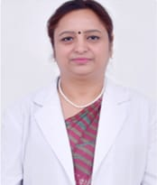
Dr. Anu Pandey Tiwari
HOD, Royal Cancer Institute, Kanpur
Dear Dr Md Shadab Alam
I hope this message finds you well. As a cancer specialist deeply invested in the well-being of my patients and the broader community, I wanted to take a moment to express my wholehearted support for your initiative to start a newsletter focused on cancer awareness, education, and support.
The journey through cancer can be incredibly challenging, not only for patients but also for their families and caregivers. In my experience, one of the most significant factors that can positively impact a patient's journey is access to reliable information and a strong support network. A newsletter dedicated to these topics can serve as a vital resource for individuals seeking guidance, understanding, and hope during such a critical time in their lives.
Your initiative has the potential to achieve several important objectives:
1. Education: Providing accurate and up-to-date information about cancer types, treatment options, and emerging research can empower patients and their families to make informed decisions about their care.
2. Support: Sharing personal stories and experiences can create a sense of community among those affected by cancer, helping them feel less isolated in their struggles.
3. Awareness: Highlighting preventive measures, early detection strategies, and the importance of regular screenings can contribute to better outcomes in our fight against cancer.
4. Resources: Offering information about local support groups, counselling services, and financial assistance programs can be invaluable to those navigating the complexities of cancer treatment.
5. Encouragement: Regularly featuring inspirational stories of survivors and their journeys can provide hope and motivation to those currently battling the disease.
As you embark on this important endeavour, I encourage you to consider collaborating with healthcare professionals, survivors, and other stakeholders who can contribute valuable insights and expertise. Together, we can create a comprehensive resource that addresses the needs of our community effectively. This initiative is commendable and reflects a genuine commitment to improving the lives of those affected by cancer. By fostering education, support, and community connection through your newsletter, you are making a meaningful contribution to our collective fight against this disease. Thank you for your dedication and hard work in bringing this vision to life.
Warm regards

Slide 24
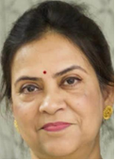
Prof. Kirti Srivastava
Department of Radiotherapy
KGMU, Lucknow
Message
This is an extremely thoughtful initiative and is probably the need of the hour. Oncological problems exclusively pertaining to the state of Uttar Pradesh can be dealt with at this platform. The need for augmenting cancer registries in order to generate exact data related to incidence and epidemiology of various malignancies, can be focused upon. This will strengthen the cancer care services which is not possible without data. Active involvement of all oncologists from UP will make this even vibrant and informative.
I wish great success on this endeavour of yours and hope this newsletter will be a valuable resource. I look forward for upcoming editions packed with the latest news and insights in oncology.
Best regards

Slide 25
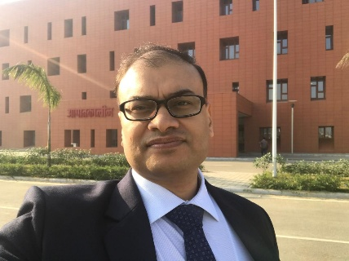
Dr Sharad Singh
Head, Department of Radiation Oncology,
Executive Registrar & Chief Medical Superintendent
Kalyan Singh Super Specialty Cancer Institute
To,
Dr Shadab Alam
Gen Secy
UPAROI Society
Dear Dr Shadab,
It gives me immense pleasure to congratulate you for your stupendous efforts for the UP AROI Chapter of our All India parent body. I am having no doubts that under the guidance of our esteemed Seniors and young fraternity like you the chapter will keep on progressing and shall achieve many milestones and accumulate many accolades in the times to come. I feel humble to be a part of UPAROI and henceforth dedicate myself for any such duties that may be asked from me for the Chapter.
Looking ahead to host all in 2026 at Lucknow
Best Regards

Slide 26
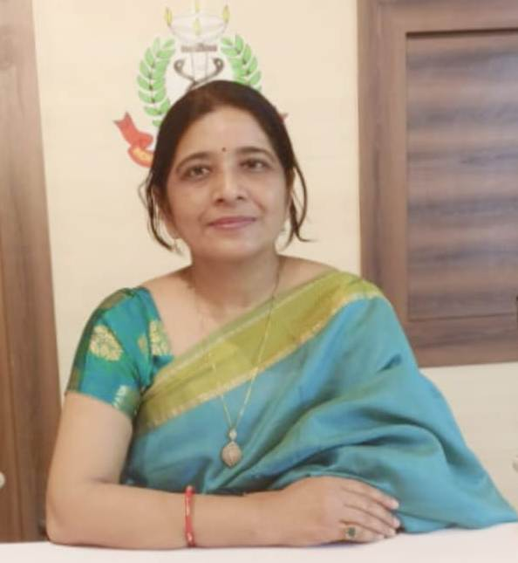
Dr. Sonia Tiwari
Senior Consultant
Radiation Oncologist
Kamala Nehru Memorial Hospital RCC Prayagraj
Dear Dr. Shadab Alam,
"I am delighted to be a part of the UPAROI Society's E-Newsletter. As we embark on this new initiative, I would like to emphasize the importance of collaboration, innovation, and patient-centered care in radiation oncology. I look forward to sharing knowledge, experiences, and best practices with the UPAROI community."
Best regards

Slide 27
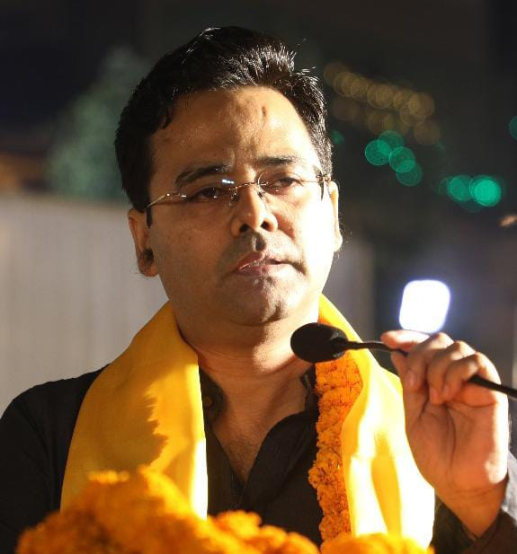
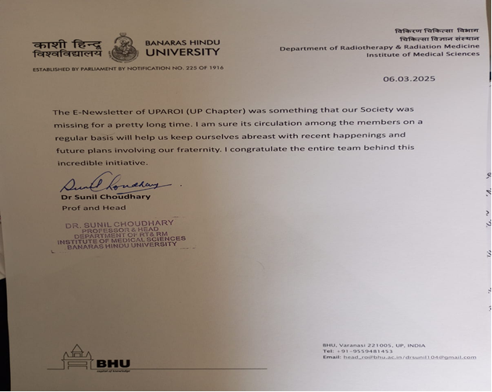
Dr Sunil Choudhary
Prof & Head
Department of RT & RM, IMS, BHU

Slide 28
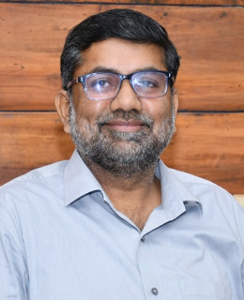
Prof Mohammad Akram
Department of Radiation Oncology
JNMC, AMU, Aligarh
It is a matter of great pleasure that the UPAROI Society has been successfully registered, and we are now moving one step ahead by launching our own newsletter. This initiative aims to bring valuable information pertaining to radiation oncology within the context of Uttar Pradesh.
I hope that the newsletter will serve as a platform to connect our members, fostering a sense of community while keeping everyone updated on the latest developments within the field. It will provide insights into ongoing activities, advancements, and achievements of radiation oncologists within the state. Through this medium, we aspire to enhance professional collaboration and maintain strong bonds among our colleagues.
Once again, my heartfelt congratulations and best wishes to the leadership for their commendable efforts in making this vision a reality.

Slide 29
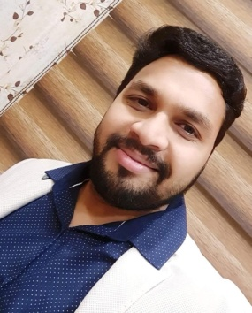
Dr Jitendra Kumar Verma
Associate Professor
JKCI, Kanpur
Hope sees the invisible, feels the intangible and achieves the impossible.

Slide 30

UPAROI Society
“Flag Bearers”
Leading Lights….

Slide 31
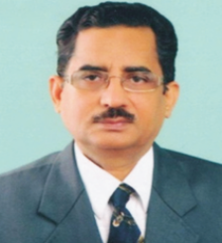
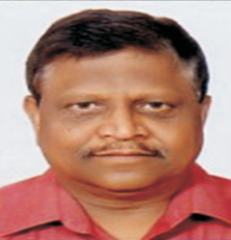
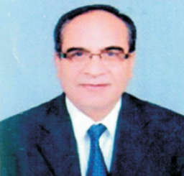
FLAG BEARERS
National Level
Name |  | Designation & Period
Dr M C Pant (RMLIMS, Lucknow) |  | National AROI President (2014-2015)
Dr U P Shahi (IMS, BHU, Varanasi) |  | National AROI President (2015-2016)
Dr MLB Bhatt (KGMU, Lucknow) |  | National AROI Vice President (2006-2008 & 2010-2012)
Dr U P Shahi (IMS, BHU, Varanasi) |  | National AROI Vice President Sr. (2014-2015)

Slide 32
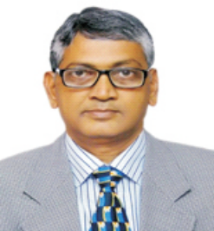
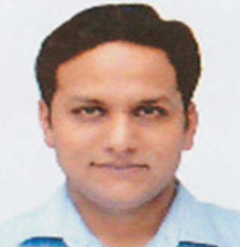
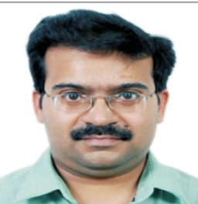
FLAG BEARERS
National Level
Name |  | Designation & Period
Dr Satyajit Pradhan (MPMMCC & HBCH, Varanasi) |  | National AROI Vice President Jr (2000-2002)
Dr Sudhir Singh (KGMU, Lucknow) |  | National AROI Vice President Jr (2015-2016)
Dr Madhup Rastogi (RMLIMS, Lucknow) |  | National AROI Vice President Jr (2016-2018)
Dr Madhup Rastogi (RMLIMS, Lucknow) |  | National AROI Joint Secretary (2012-2016)

Slide 33
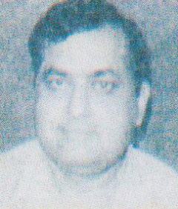
FLAG BEARERS
National Level
Name |  | Designation & Period
Dr A K Dixit (JKCI, Kanpur) |  | National AROI Joint Secretary (1992-1994)
Dr Satyajit Pradhan (MPMMCC & HBCH, Varanasi) |  | ICRO Chairman (2018-2021)
Dr Satyajit Pradhan (MPMMCC & HBCH, Varanasi) |  | ICRO Vice Chairman (2014-2016)
Dr Madhup Rastogi (RMLIMS, Lucknow) |  | ICRO Vice Chairman (2022-2024)

Slide 34
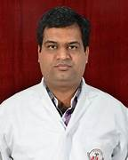
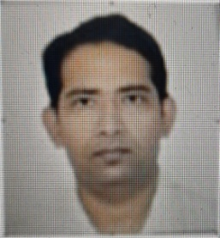
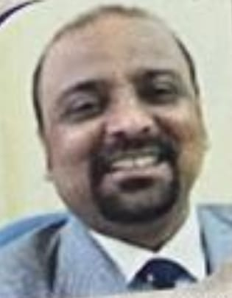
FLAG BEARERS
National Level
Name |  | Designation & Period
Dr Satyajit Pradhan (MPMMCC & HBCH, Varanasi) |  | ICRO Secretary (2016-2018)
Dr Piyush Kumar (SRMS, Bareilly) |  | ICRO Joint Secretary (2022-2024)
Dr Ajeet Gandhi (RMLIMS, Lucknow) |  | YORF (2022-24)
Dr L M Aggarwal (IMS, BHU, Varanasi) |  | National AROI Physics Representative (2018-22)

Slide 35
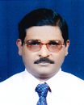
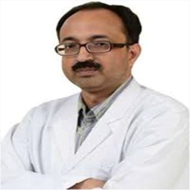
FLAG BEARERS
National Level
Name |  | Designation & Period
Dr Rajendra Kumar (KGMU, Lucknow) |  | National AROI Physics Representative (1996-98)
Dr Pawan Kumar (SRMS, Bareilly) |  | AROI – AP Chapter General Secretary (2004-06)

Slide 36

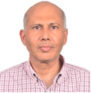
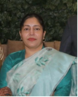
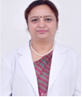
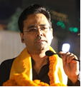
FLAG BEARERS
STATE Level (UPAROI)
Period | President | General Secretary
2023-25 | Dr Pawan Kumar (SRMS, Bareilly) | Dr Md Shadab Alam (JNMC, AMU, Aligarh)
2021-23 | Dr Shaleen Kumar (SGPGI, Lucknow) | Dr Surabhi Gupta (SNMC, Agra)
2018-21 | Dr Anu Tiwari (Royal Cancer Institute, Kanpur) | Dr Sunil Choudhary (IMS, BHU, Varanasi)

Slide 37
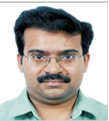

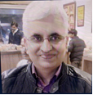


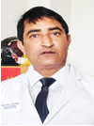
FLAG BEARERS
STATE Level (UPAROI)
Period | President | General Secretary
2016-18 | Dr Madhup Rastogi (RMLIMS, Lucknow) | Dr Ankita Patel (Apex Hospital, Varanasi)
2014-16 | Dr B K Mishra (Prayagraj) | Dr Piyush Kumar (SRMS, Bareilly)
2012-14 | Dr A K Chaturvedi (Dr Chaturvedi Cancer Hospital, Gorakhpur) | Dr M Q Baig (JKCI, Kanpur)

Slide 38
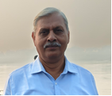
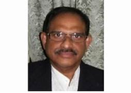
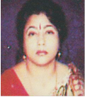
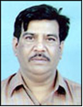
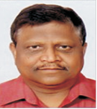
FLAG BEARERS
STATE Level (UPAROI)
Period | President | General Secretary
2008-12 | Dr A K Arya (SNMC, Agra) | Dr Surabhi Gupta (SNMC, Agra)
2006-08 | Dr B Paul Thailliath (RCC, KNMH, Prayagraj) | Dr Radha Rani Ghosh (RCC, KNMH, Prayagraj)
2004-06 | Dr A K Ashthana (IMS, BHU, Varanasi) | Dr U P Shahi (IMS, BHU, Varanasi)

Slide 39


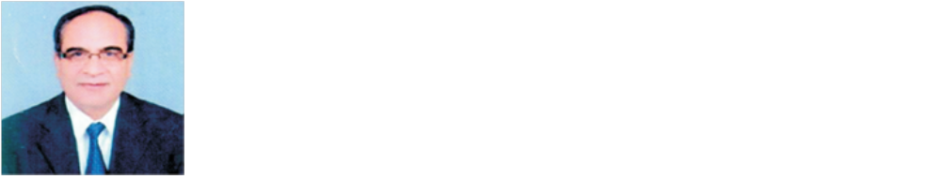
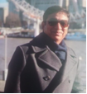


FLAG BEARERS
STATE Level (UPAROI)
Period | President | General Secretary
2002-04 | Dr J N Dwivedi (JKCI, Kanpur) | Dr Rajnish K Jauhari (JKCI, Kanpur)
1998-2002 | Dr MLB Bhatt (KGMU, Lucknow) | Dr S A Siddiqui (JNMC, AMU, Aligarh)
1994-98 | Dr A K Dixit (JKCI, Kanpur) | Dr Madhu Srivastava (KGMU, Lucknow)

Slide 40

UPAROI Society
“Refreshing Old Sweet Memories”

Slide 41
The First UP Chapter Convention of AROI
(From the Annals of the History of UP Chapter of AROI)
The Journey of UP Chapter Convention of AROI started in 1988. The Department of Radiotherapy, KGMC, Lucknow organized the convention, at Hotel Clarks Avadh, Lucknow, on 19th November. The Patrons of the programme were Hon’ble Shri G N Dixit (Health Minister, UP), Prof (Mrs) S Verma (Director, Med Education, UP) & Prof B N Lall (Ex HOD of Radiology & Principal, KGMC, Lucknow). The Organizing Chairman was Prof G N Agarwal, and the Organizing Secretary was Dr H R Mali. Till now, 35 UP Chapter Convention of AROI have been held, with the last one organized by RCC, KNMH, Prayagraj in November 2024. The next UP Chapter Convention of AROI is scheduled to be organized by Dr Chaturvedi Cancer Hospital, Gorakhpur (36th UPAROICON in 2025) and KSSSCI, Lucknow (37th UPAROICON in 2026). Apart from conduction of various academic activities, Two Orations (Dr B N Lall Oration – started in 1988 and Dr M C Pant Oration – started in 2016) are given each year in the UP Chapter Convention of AROI, to distinguished members of the UPAROI Society, for their contribution in the field of Oncology. The Recipient of the first Dr B N Lall Oration was Dr. G. C. Pant (IMS, BHU, Varanasi) in 1st UPAOICON, 1988 organized by KGMU, Lucknow. The first Dr M C Pant Oration was given by Dr Goura Kishor Rath (NCI & AIIMS, New Delhi) in 27th UPAOICON, 2016 organized by Dr RMLIMS, Lucknow.

Slide 42

Dr B. N. Lall Oration
Prof Brij Nandan Lall, 8th April 1918 - 17th March 1999
Dr B.N. Lall was a product of King George’s Medical College, Lucknow. He joined the college in 1935 and after a meritorious medical career, graduated in 1940, standing first in Medicine, Surgery and Ophthalmology with distinction in Anatomy and Jurisprudence. After his houseman ship, he was appointed as Kunwar Indrajeet Research Scholar in Radiology. During this period, he did D.M.R.E and M.D. in medicine. He was appointed Lecturer in Radiology in 1946, Reader in Radiology in 1960 and Professor in Radiology in 1961. In 1975, he was appointed Principal of K.G. Medical College, Lucknow in which capacity he continued till his retirement on 30th July 1978.
Professor B.N. Lall Oration was started in 1988 during the First U.P. Chapter Convention of A.R.O.I. to honour the lifelong dedicated services of Professor B.N. Lall in Radiotherapy and Radiology for the cause of cancer patients.

Slide 43

Dr M C Pant Oration
Padmashri Prof. Mohan Chand Pant
MD, FICS, FAMS, FICR, D.Sc.
(11th Oct 1956-13th Aug. 2015)
President of Association of Radiation Oncologists of India (AROI), Founding Voice Chancellor, Hemwati Nandan Bahuguna Uttarakhand Medical University
Former Director, Ram Manohar Institute of Medical Sciences
Former Head, Radiotherapy Department, C.S.M. Medical University
Formerly King, George Medical College, Lucknow
Mohan Chandra Pant (1956–2015) was an Indian radiation oncologist, institution builder and the founder vice chancellor of the H. N. B. Uttarakhand Medical Education University, Dehradun. He served as the director of Dr. Ram Manohar Lohia Institute of Medical Sciences, Lucknow, and was the Dean and head of the Radiotherapy Department at the King George's Medical University at the time of his death. He received the Dr. B. C. Roy Award, the highest Indian award in the medical category, from the Medical Council of India in 2005. The Government of India awarded him the fourth highest civilian honour of the Padma Shri, in 2008, for his contributions to medicine.

Slide 44
Dr M C Pant Oration
Biography
Mohan Chandra Pant was born at Kunkoli, a small village in Ranikhet in the undivided Uttar Pradesh (presently in Uttarakhand) in a family with limited financial means. His early schooling was at the local village school, after which he graduated in Science (BSc) from Kumaon University in 1974, and continued his studies at King George's Medical University (KGMU) from where he obtained his MBBS in 1979 and MD in 1985. His career started as a member of faculty at his alma mater, but moved to Tokyo in 1986 for advanced training in CT Scan at the University of Tokyo. Returning to India, he joined KGMU and established a CT Scan unit at the institution, the first such unit in the public sector in the state. He also had training in Magnetic resonance imaging techniques in Germany and radiation oncology at the Union for International Cancer Control, Geneva, California State University, Long Beach, University of Texas MD Anderson Cancer Center and Rush University. Chicago. He became the director of the Department of Radiotherapy at KGMU in 2007 and held the post till 2010. In September 2010, he moved to Dr. Ram Manohar Lohia Institute of Medical Sciences, Lucknow, as its director, where he worked for three years till September 2013. Thereafter, he was associated with the establishment of H.N.B. Uttarakhand Medical Education University at Dehradun and when institution became operational in 2014, he was appointed as its founding vice chancellor. Returning to KGMU, he served as the Dean of the Dean and head of the Radiotherapy Department at the institution. During brief interludes, he served as a visiting professor at Tokyo University, Rush University, California University, University of Texas MD Anderson Cancer Center, Dichin Barge University, Germany, Chinese University of Hong Kong, and Roswell Park Comprehensive Cancer Center.
Pant was married to Nirmala Pant, the director of Lucknow Cancer Institute, and the couple had a son and a daughter. He died on 13 August 2015, at Lucknow Cancer Institute, succumbing to liver cancer for which he was under treatment for six months.

Slide 45
Dr M C Pant Oration
Legacy
Besides setting up the first CT Scan unit in the non-private sector in the state of Uttar Pradesh at KGMU in the Eighties, Pant's contribution is reported behind the founding of several institutions. The Lucknow Cancer Institute, Lucknow, where eventually his death occurred in 2015, was one of the institutions he helped establish. His efforts have also helped in the establishment of the Swami Ram Memorial Cancer Hospital and Research Center and Dr. Susheela Tiwari Memorial Cancer Hospital and Research Center, both divisions of the Government Medical College, Haldwani, and Rural Cancer Hospital, Mainpuri, an institution under the H. N. B. Uttarakhand Medical Education University. It was during his tenure as the director, a High Dose Rate Brachytherapy (HDR-BT) unit and a radiotherapy simulator (Simulix Evolution, Nucletron) were installed at KGMU. While heading the Dr. Ram Manohar Lohia Institute of Medical Sciences, his efforts helped in the modernization of the hospital by installing several medical systems and equipment, including Lithotripsy, Cath Lab and Pathology & Cytopathology facilities web compatible digital X-ray system, 3 Tesla MRI, 16 Slice CT-SIM with LASER positioning system, Multi-energy Elekta Infinity LINAC, mHDR (Ir-192) system for Brachytherapy, Mammography X-ray System, Photo Dynamic Therapy (PTD) and Single Photon Emission Computed tomography (SPECT-CT). The Cancer Indoor Ward, Out Patient Department (OPD–II), Microbiology Department, and High Dose Radioiodine ward were started functioning during his directorship.
Pant's involvement in the Cancer Control Programme in Uttarakhand has helped in the establishment of 10 cancer detection centres across the state. His researches, including the one on the genetic transformation due to tobacco use, have been documented by 89 medical papers published in national and international journals, 5 books and chapters in 5 other books. He was the organizer of a school-based cancer education project involving 297 teachers and around 60,000 students in 13 districts of the state and was also known to have delivered several keynote addresses and orations. He also contributed to the establishment of a Picture Gallery, covering the 100 years of history of the King George's Medical University, in connection with the centenary celebrations of the institution.

Slide 46
Dr M C Pant Oration
Awards and honours
Pant, who was listed among 20 Great Indians by India Today and an elected fellow of the National Academy of Medical Sciences, was a recipient of the P. K. Haldar Memorial Award (1990) and Hukum Chand Jain Memorial Award (2003). The Medical Council of India awarded him the highest Indian medical award of Dr. B. C. Roy Award in 2005. The Government of India included him the 2008 Republic Day honours list for the civilian honour of the Padma Shri. The same year, Kumaon University, his alma mater, awarded him the degree of Doctor of Science (honoris causa). He was also a recipient of awards such as Professor K. B. Kunwar Memorial Award (1986, 88 and 89), Prasad Memorial Award of the Indian Radiology and Imaging Association (1987), International Cancer Technology Transfer Award of the Union for International Cancer Control (1993), Best Social Worker Award of the Lucknow chapter of the Rotary International (2001) and Dr. Birbal Sahni Award (2008).

Slide 47

The First Recipient of Dr B N Lall Oration
DR. G.C. PANT
(28/01/1936 – 15/06/2002)
Prof. Girish Chandra Pant popular as Girish or Pant, amongst his friends & seniors, completed his MBBS from King George’s Medical College (KGMC), Lucknow in 1960, DMRE in 1962 and MD (Radiology-combined diagnosis & therapy) in 1964. He began his professional career a Assistant Radiotherapist at KGMC in 1964. In 1965 he moved to the Institute of Medical Sciences. Banaras Hindu University & along with Prof. A.D. Singh, was instrumental in building up the Department of Radiotherapy at BHU.
He also took up the task, along with his colleagues there, in starting the courses of DMRD and subsequently MD (Radiotherapy) at BHU. He has been one of the founder members of the Association of Radiation Oncologists of India, founder member of the Indian College of Radiation Oncology and member of the first executive body of AROI. Prof. Pant took up the initiative in organizing the second Annual Conference of AROI at Varanasi in 1978 and has made an important contribution to the growth of the association & the specialty in the country.

Slide 48
The First Recipient of Dr B N Lall Oration
DR. G.C. PANT
(28/01/1936 – 15/06/2002)
Prof. Pant was Dean, faculty of Medicine of Banaras Hindu University and acting Vice-Chancellor of BHU from June 13, 1993 to Dec 13,1993. He retired form active service from BHU on January 31, 1996 & spent his retired life doing voluntary medical and social service at Varanasi.
It is an irony of fate that the man who spent his life fighting against the dreaded disease “Cancer” fell a victim to this very disease. In May 2001, Prof. Pant was diagnosed to be having a brain tumor that subsequently turned out to be Glioblastoma Multiforme of the right frontal lobe of the brain.
He was operated, received chemotherapy and was well for a while. Then again in early 2002, began a down hill course and he breathed his last in the evening of June 15, 2002. Thus came the end to an illustrious career of an excellent medical man who rose to eminence as a direct result of his hard work and who brought excellent fortune to all those who have interacted with him not only his professional capacity but also in his personal life.

Slide 49

UPAROICOn (HISTORY)
UPAROICON | Year | Host Institute | Dr B N Lall Oration | Dr M C Pant Oration
1st | 1988 | KGMU, Lucknow | Dr. G. C. Pant (IMS, BHU, Varanasi) | -
2nd | 1989 | - | Dr. Prem Narain (JKCI, Kanpur) | -
3rd | 1990 | Dr Chaturvedi Cancer Hospital, Gorakhpur | Dr. O P Trehan (Hanuman Poddar Hospital, Gorakhpur) | -

Slide 50

UPAROICOn (HISTORY)
UPAROICON | Year | Host Institute | Dr B N Lall Oration | Dr M C Pant Oration
4th | 1991 | - | Dr. S. Ayyagiri (SGPGI, Lucknow) | -
5th | 1992 | - | Dr. Y C Agrawal (Keshlata Hospital, Bareilly) | -
6th | 1993 | - | Dr. H R Mali (KGMU, Lucknow) | -

Slide 51


UPAROICOn (HISTORY)
UPAROICON | Year | Host Institute | Dr B N Lall Oration | Dr M C Pant Oration
7th | 1994 | - | Dr. Kamal Sahani (JKCI, Kanpur) | -
8th | 1995 | - | Dr B Paul Thalliath (RCC, KNMH, Prayagraj) | -
9th | 1996 | - | Dr. M S Agrawal (IMS, BHU, Varanasi) | -

Slide 52
UPAROICOn (HISTORY)
UPAROICON | Year | Host Institute | Dr B N Lall Oration | Dr M C Pant Oration
10th | 1997 | - | - | -
11th | 1998 | - | - | -
12th | 1999 | - | - | -

Slide 53



UPAROICOn (HISTORY)
UPAROICON | Year | Host Institute | Dr B N Lall Oration | Dr M C Pant Oration
13th | 2000 | - | Dr. S P Misra (RCC, KNMH, Prayagraj) | -
14th | 2001 | KGMU, Lucknow | Dr. R N L Srivastva (JKCI, Kanpur) | -
15th | 2001 | Keshlata Hospital, Bareilly | Dr N R Datta (SGPGI, Lucknow) | -

Slide 54


UPAROICOn (HISTORY)
UPAROICON | Year | Host Institute | Dr B N Lall Oration | Dr M C Pant Oration
16th | 2002 | JKCI, Kanpur | Dr. U. P. Shahi (IMS, BHU, Varanasi) | -
- | 2003 | - | - | -
17th | 2004 | IMS, BHU, Varanasi | Dr Madhu Srivastava (KGMU, Lucknow) | -

Slide 55

UPAROICOn (HISTORY)
UPAROICON | Year | Host Institute | Dr B N Lall Oration | Dr M C Pant Oration
18th | 2005 | KGMU, Lucknow | Dr. R K Katiyar (JKCI, Kanpur) | -
- | 2006 | - | - | -
19th | 2007 | - | Dr. J N Dwivedi (JKCI, Kanpur) | -

Slide 56


UPAROICOn (HISTORY)
UPAROICON | Year | Host Institute | Dr B N Lall Oration | Dr M C Pant Oration
20th | 2008 | SGPGI, Lucknow | Dr. A K Dixit (JKCI, Kanpur) | -
21st | 2008 | SNMC, Agra | Dr. I. C. Khare (JKCI, Kanpur) | Dr. B. D. Gupta (Dr G C Pant Oration)
22nd | 2009 | - | Dr. T Laxmi (N.E.R.C.I, Varanasi) | -

Slide 57

UPAROICOn (HISTORY)
UPAROICON | Year | Host Institute | Dr B N Lall Oration | Dr M C Pant Oration
23rd | 2010 | - | - | -
24th | 2011 | Dr Chaturvedi Cancer Hospital, Gorakhpur | Dr Shahid Ali Siddiqui (JNMC, AMU, Aligarh) | -
25th | 2012 | - | - | -

Slide 58

UPAROICOn (HISTORY)
UPAROICON | Year | Host Institute | Dr B N Lall Oration | Dr M C Pant Oration
- | 2013 | - | - | -
26th | 2014 | SRMSIMS, Bareilly | Dr K J Maria Das (SGPGI, Lucknow) | -
- | 2015 | - | - | -

Slide 59






UPAROICOn (HISTORY)
UPAROICON | Year | Host Institute | Dr B N Lall Oration | Dr M C Pant Oration
27th | 2016 | Dr RMLIMS, Lucknow | Dr Shaleen Kumar (SGPGI, Lucknow) | Dr Goura Kishor Rath (NCI & AIIMS, New Delhi)
28th | 2016 | Apex Hospital, Varanasi | Dr. MLB Bhatt (KGMU, Lucknow) | Dr Neeraj Rastogi (SGPGI, Lucknow)
29th | 2017 | Royal Cancer Institute & Research Centre, Kanpur | Dr. Satyajeet Pradhan (MPMMMCC, Varanasi) | Dr B K Mohanti (AIIMS, New Delhi)

Slide 60



UPAROICOn (HISTORY)
UPAROICON | Year | Host Institute | Dr B N Lall Oration | Dr M C Pant Oration
30th | 2018 | IMS, BHU, Varanasi | Dr Ashok Kr Arya (SNMC, Agra) | Dr B Paul Thalliath (RCC, KNMH, Prayagraj)
31st | 2019 | SGPGI, Lucknow | Dr Radha Rani Ghosh (RCC, KNMH, Prayagraj) | Dr Ravi Kannan R (Cachar Cancer Hospital and Research Centre (CCHRC), Silchar)
- | 2020 | - | - | -

Slide 61




UPAROICOn (HISTORY)
UPAROICON | Year | Host Institute | Dr B N Lall Oration | Dr M C Pant Oration
32nd | 2021 | SNMC, Agra | Dr S N Prasad (JKCI, Kanpur) | Dr Sapna Nangia (Apollo Hospital, Delhi)
33rd | 2022 | SRMSIMS, Bareilly | Dr Manoj Gupta (AIIMS, Rishikesh) | Dr N R Datta (SGPGI, Lucknow)
34th | 2023 | JNMC, AMU, Aligarh | Dr Neeraj Rastogi (SGPGI, Lucknow) | Dr Punita Lal (SGPGI, Lucknow)

Slide 62


UPAROICOn (HISTORY)
UPAROICON | Year | Host Institute | Dr B N Lall Oration | Dr M C Pant Oration
35th | 2024 | RCC, KNMH, Prayagraj | Dr Sushma Agrawal (SGPGI, Lucknow) | Dr A K Chaturvedi (Dr Chaturvedi Cancer Hospital, Gorakhpur)
36th | 2025 | Dr Chaturvedi Cancer Hospital, Gorakhpur | Awaited | Awaited
37th | 2026 | KSSSCI, Lucknow | Awaited | Awaited

Slide 63

(1st UPAROICON, 1988, KGMU, Lucknow)
(Courtesy – Dr Madhup Rastogi)

Slide 64


(14th UPAROICON, 2001, KGMU, Lucknow)
(Courtesy – Dr Madhup Rastogi)
(15th UPAROICON, 2001, Keshlata Hospital, Bareilly)
(Courtesy – Dr Madhup Rastogi)

Slide 65


(17th UPAROICON, 2004, IMS, BHU, Varanasi)
(Courtesy – Dr Madhup Rastogi)
(18th UPAROICON, 2005, KGMU, Lucknow)
(Courtesy – Dr Shalini Singh)

Slide 66


(20th UPAROICON, 2008, SGPGI, Lucknow)
(Courtesy – Dr Madhup Rastogi)
(21st UPAROICON, 2008, SNMC, Agra)
(Courtesy – Dr Surabhi Gupta)

Slide 67


(27th UPAROICON, 2016, Dr RMLIMS, Lucknow
(Courtesy – Dr Madhup Rastogi)
(32nd UPAROICON, 2021, SNMC, Agra)
(Courtesy – Dr Surabhi Gupta)

Slide 68


(33rd UPAROICON, 2022, SRMSIMS, Bareilly)
(Courtesy – Dr Pawan Kumar)
(34th UPAROICON, 2023, JNMC, AMU, Aligarh)
(Courtesy – Dr Md Shadab Alam)

Slide 69

(35th UPAROICON, 2024, RCCKNMH, Prayagraj)
(Courtesy – Dr Sonia Tiwari)

Slide 70
Thank You

